Slide 1

Chandigarh University
Department of Mathematics
B.Tech. CSE (Core/DS/IT/CC)
Semester-3
Subject Code:25MTT-202
Discrete Mathematics
Unit - 5 (Chapter- 5.1.2)
Dr. SARTAJ
DISCOVER . LEARN . EMPOWER

Slide 2

CO mappings

Slide 3

CO-PO mappings
Note: Degree of relevance/correlation: 1-Low, 2-Medium, 3-High, Blank or ‘- ‘- Nil

Slide 4
Topics Overview
Complete graph, Homomorphism
Conclusions
Video links
References

Slide 5
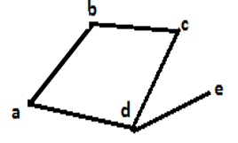
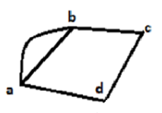
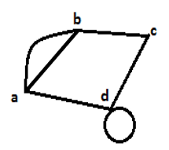
Types of Graph
Simple graph: A graph without loops and parallel edges.
Multigraph: A graph which consists of multiple edges but not self loops is called multigraph.
Pseudo graph: A pseudo graph is a type of graph that allows both loops and multiple edges.
ns

Slide 6
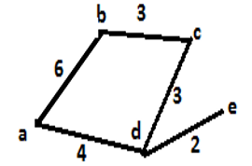
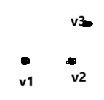

Types of Graph
Weighted graph: A graph where each edge is assigned a numerical label or “weight”.
Null graph: A null graph is a graph having only vertices but not edges. It means it has only isolated vertices.
Trivial graph: A trivial graph is a graph having only one vertex and no edges.
ns

Slide 7
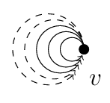


Types of Graph
Finite graph: A finite graph is a graph with a finite number of vertices and edges.
Infinite graph: An infinite graph has either infinitely many vertices, infinitely many edges, or both.
Directed graph: A directed graph (digraph) is a graph where each edge has a direction, otherwise un-directed.
ns

Slide 8


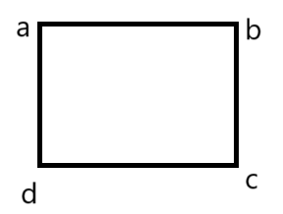

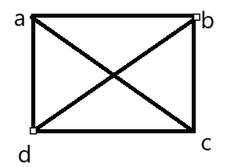
Types of Graph
K-regular graph: A k-regular graph is a type of graph in which every vertex has exactly 𝑘 edges connected to it. The degree of every vertex in a K-regular graph is k.
Examples:
1-regular
2-regular
3-regular
ns

Slide 9

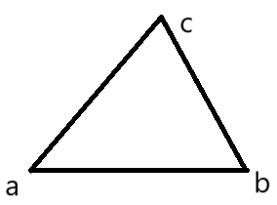
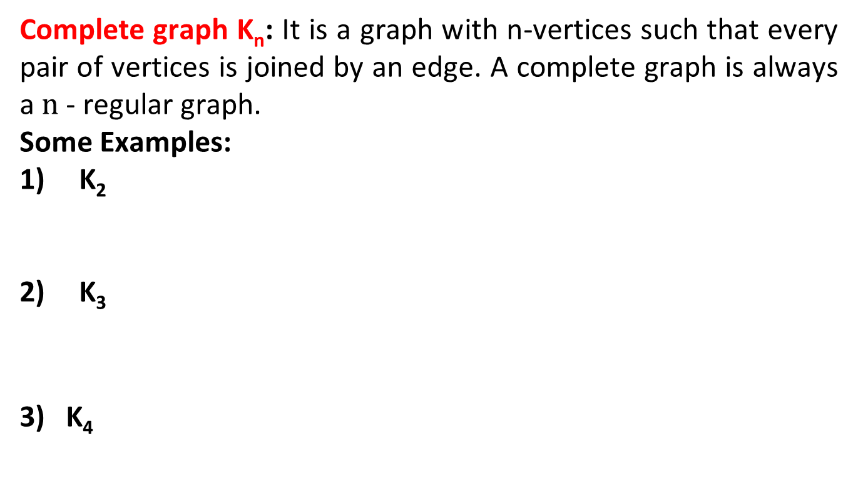
Types of Graph
Complete graph K_{n}: It is a graph with n-vertices such that every pair of vertices is joined by an edge. A complete graph is always a $n$- regular graph.
Some Examples:
K₂
K₃
3) K₄
ns

Slide 10

Types of Graph
Note: No. of edges in a complete graph
K_{n} = $\frac{n(n−1)}{2}$
Example: No. of edges in K₅
_{= 5 (5-1)/2 = 10.}
ns

Slide 11
Isomorphic Graphs
Isomorphic graphs: Two graphs G₁ = (V₁, E₁) and G₂ = (V₂, E₂) are called isomorphic if there is one to one correspondence between the edge sets E₁ and E_{2,} the vertex sets V₁ and V₂ in such a way that if e₁ is an edge between u₁ and v₁ in G₁ then correspondence edge e₂ between u₂ and v₂ in G_{2.}
Note: If Two graph are isomorphic of each other then (not vice versa)
They have same number of edges and same number of vertices.
They have equal number of vertices with a given degree.
ns

Slide 12
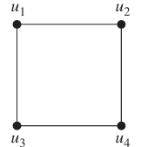
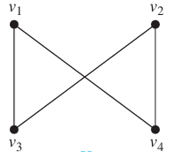
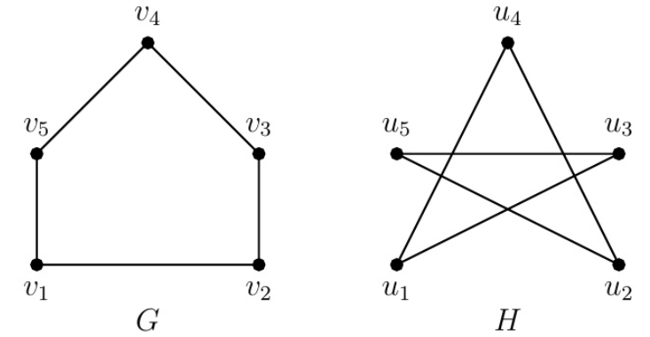
Isomorphic Graphs
Example:
and are isomorphic as
are isomorphic as
ns

Slide 13
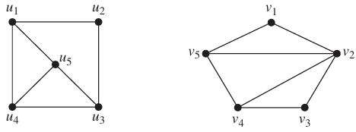
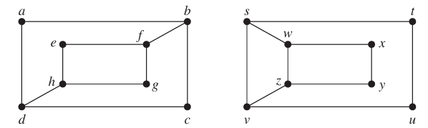
Activity-1
Check the following pair of graphs for isomorphism.
1)
2)

Slide 14
Conclusion
Types of Graph and Isomorphic are discussed.
Related examples are given.
ns

Slide 15
Video Links
https://youtu.be/A68kxz0-Smo?si=jNmRORHF-b0We6VL
https://youtu.be/5m2UWlqy6ww?si=dSH76_n1wgMZY_WY
(Video Links)
https://drive.google.com/file/d/1zm_o2dthNGIi-OXsgP8McUz4SUlb9q3p/view?usp=sharing
(Book Link)

Slide 16
References
Sr. No. | Author | Name of the Book | Publisher | Year of Publication
1 | Kenneth H. Rosen | Discrete Mathematics and Its Applications | McGraw-Hill | 2019
2 | C. L. Liu | Elements of Discrete Mathematics | McGraw-Hill | 1996
3 | J. P. Tremblay, R. Manohar | Discrete Mathematical Structures with Applications to Computer Science | Tata McGraw Hill | 2001
4 | Kolman, Busby, Ross | Discrete Mathematical Structures | PHI | 2001
5 | Narsingh Deo | Graph Theory with Applications to Engineering and | PHI | 2017

Slide 17
Thanks!!!

